Slide 1
Secure mobile cloud environment
Mobile and cloud authentication

Slide 2
Cloud is the future
Most cloud service providers using weak authentication mechanisms.
Username/password
Cloud provider, hackers can access user’s data.
More and more sensitive data is being collected.
Encryption on mobile phone requires high workload.

Slide 3
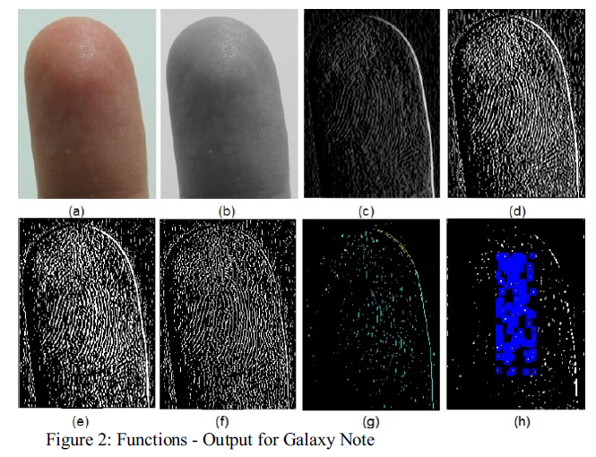
Fingerprint Authentication

Slide 4
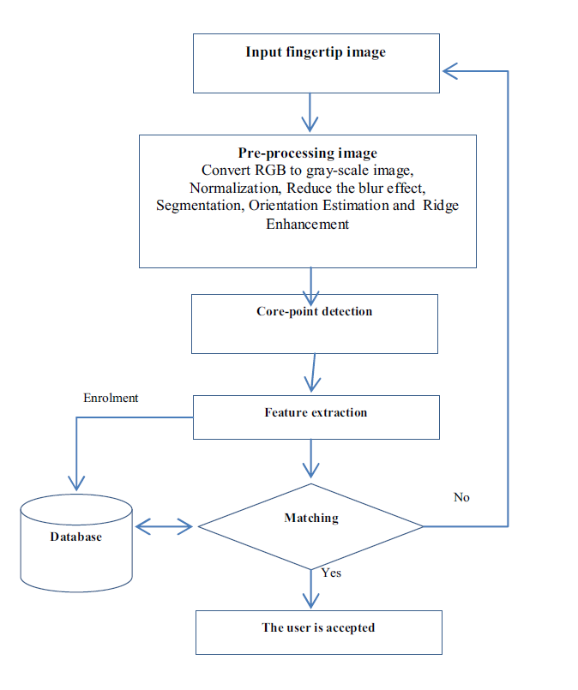
DESIGN APPROACH

Slide 5
Pros and cons:
Pros:
It is not expensive by using camera on the phone.
Cons:
If the server is hacked, the user will lose every thing.
The image is not encrypted.

Slide 6
Sesame
“Sesame” in honor of the story of “Ali Baba and the Forty Thieves”.
Voice-activated password manager.
A speaker and speech recognition.
A killer for LastPass, Firefox Sync, Apple Keychain…

Slide 7
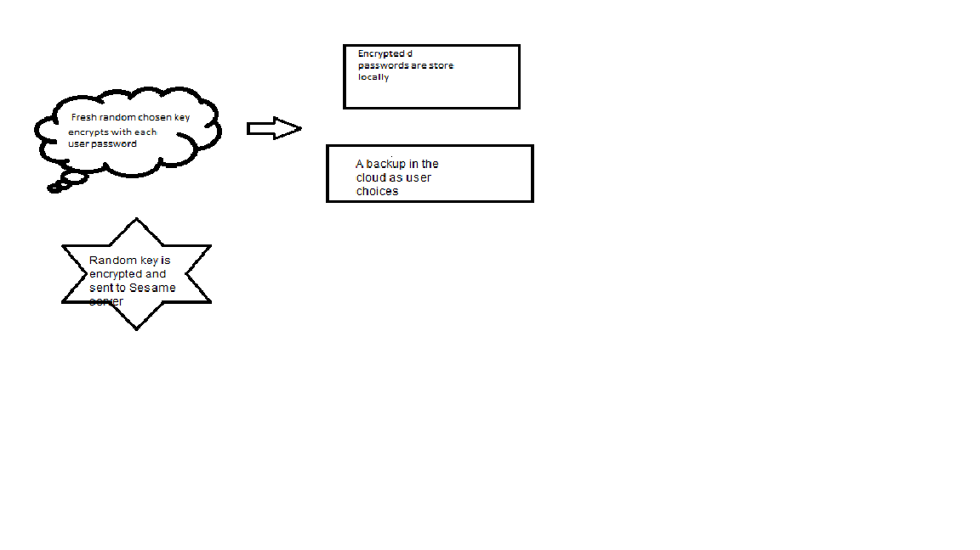
Proposed solution (1)

Slide 8
Proposed solution (2)
Master key is set up when user launch the application 1st time.
A key is created using this master password.
On Sesame sever, the key is protected by using the voice authentication.
Speaker recognition and speech recognition are applied.
In order to retrieve the key, user has to use their voice.

Slide 9
Pros and cons
Pros:
Sesame server knows nothing about the data even though it has the keys.
Every phone has a speaker and phone .
Any attack on the Sesame server will not bring headache to user.
Cons:
Expensive solution.
Hard to scale out because different people have different sounds for every languages.
Performance.

Slide 10
References:
Rassan, Iehab Al, and Hanan Alshaher. "Securing Mobile Cloud Computing Using Biometric Authentication (SMCBA)." 2014 International Conference on Computational Science and Computational Intelligence (2014)
Aliasgari, Mehrdad, Nick Sabol, and Ashutosh Sharma. "Sesame: A Secure and Convenient Mobile Solution for Passwords." 2015 First Conference on Mobile and Secure Services (MOBISECSERV) (2015)

